Slide 1
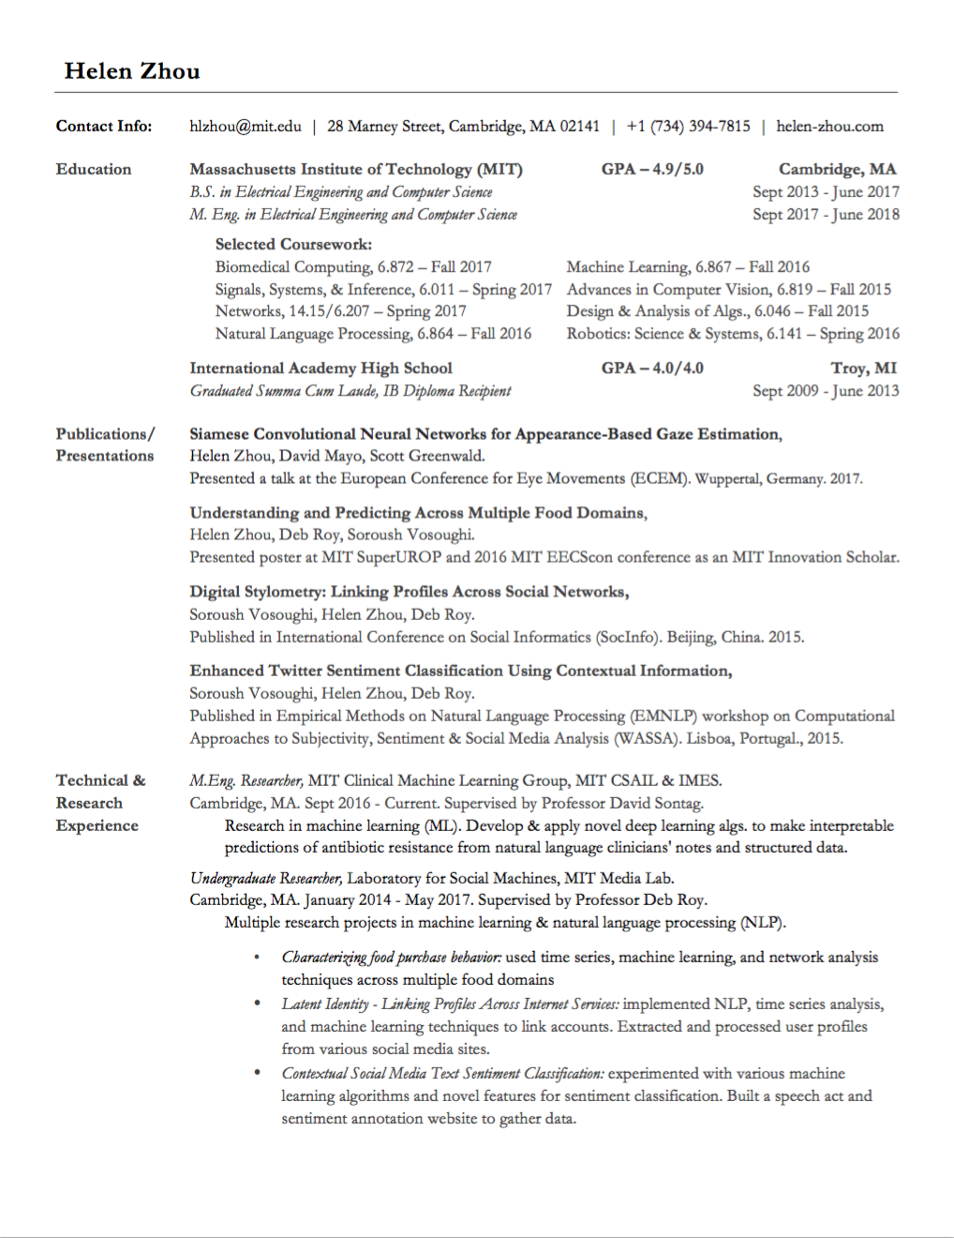

Slide 2
Research Projects

Slide 3
?

Slide 4


Slide 5


Slide 6
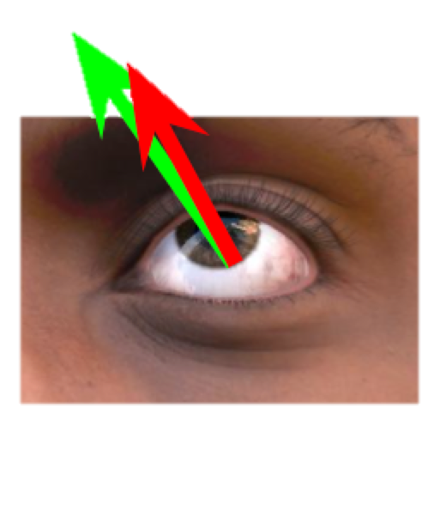

Slide 7
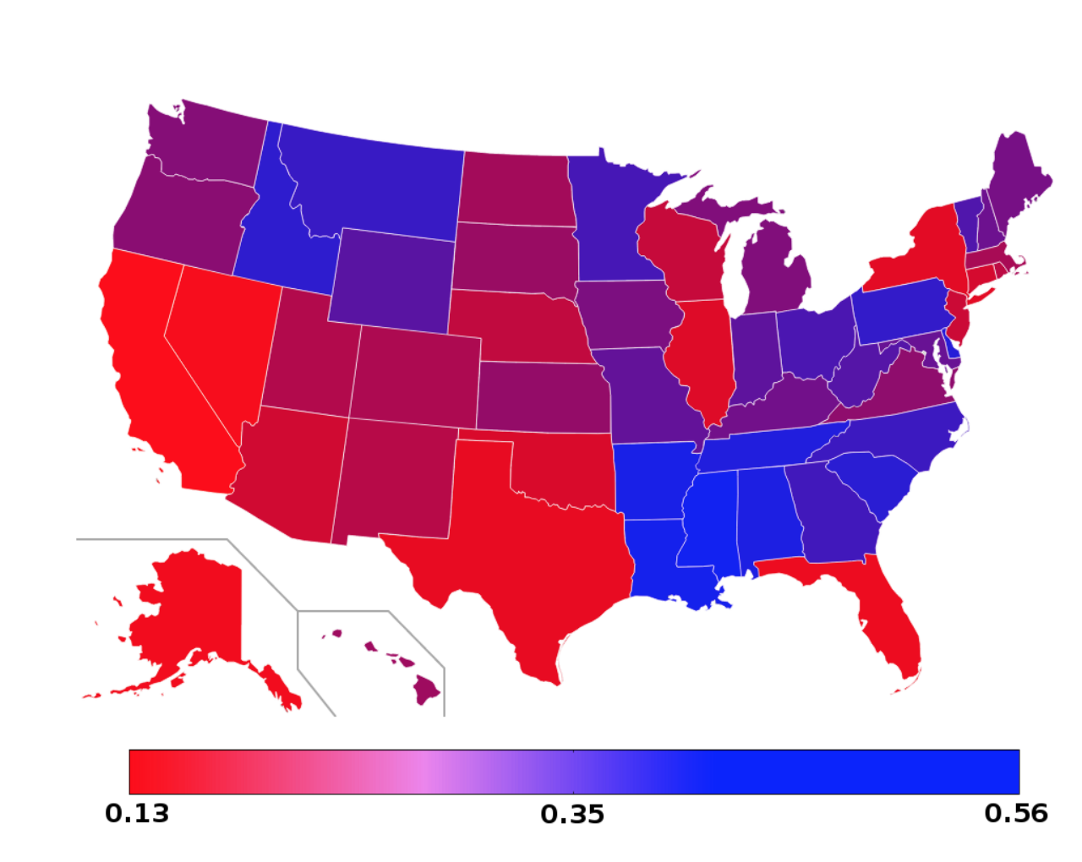

Slide 8




Slide 9
Industry Projects

Slide 10


Slide 11



Slide 12


Slide 13


Slide 14



Slide 15
Other projects

Slide 16


Slide 17
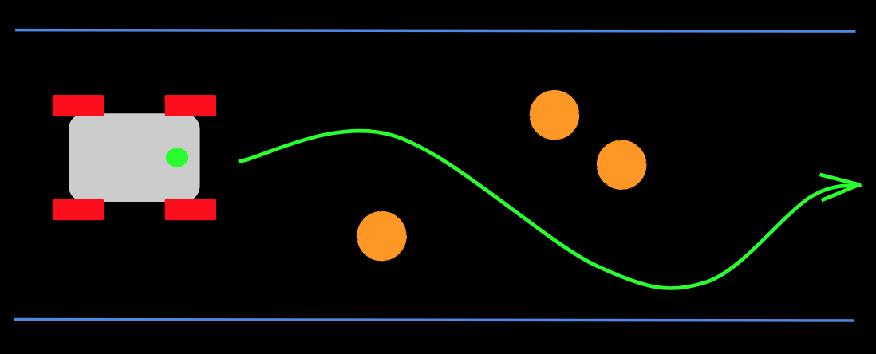
Notes:
https://docs.google.com/presentation/d/13k8iGIH2nB-TQ_WaXT0tk96utYuh3z80OLkxh7Xn_fU/edit#slide=id.g10eeaeb5ae_0_5

Slide 18


Slide 19


Slide 20


Slide 21
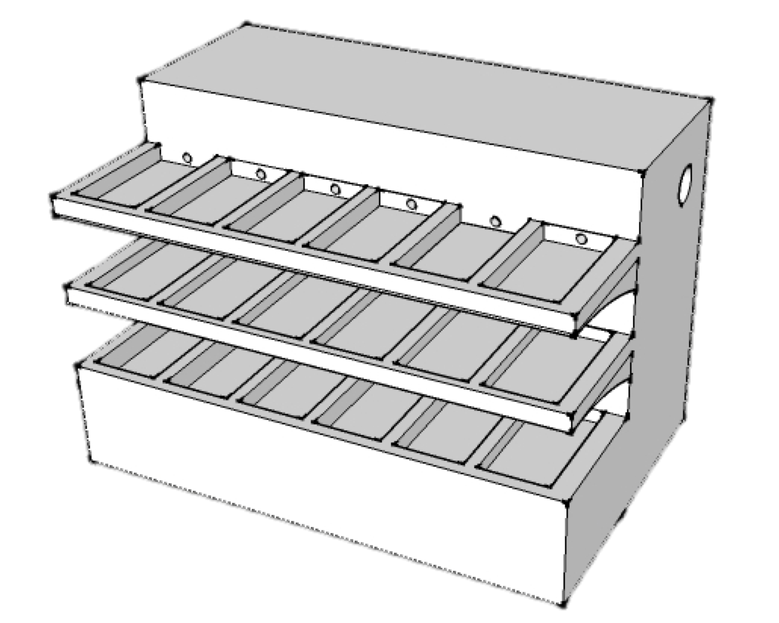

Slide 22
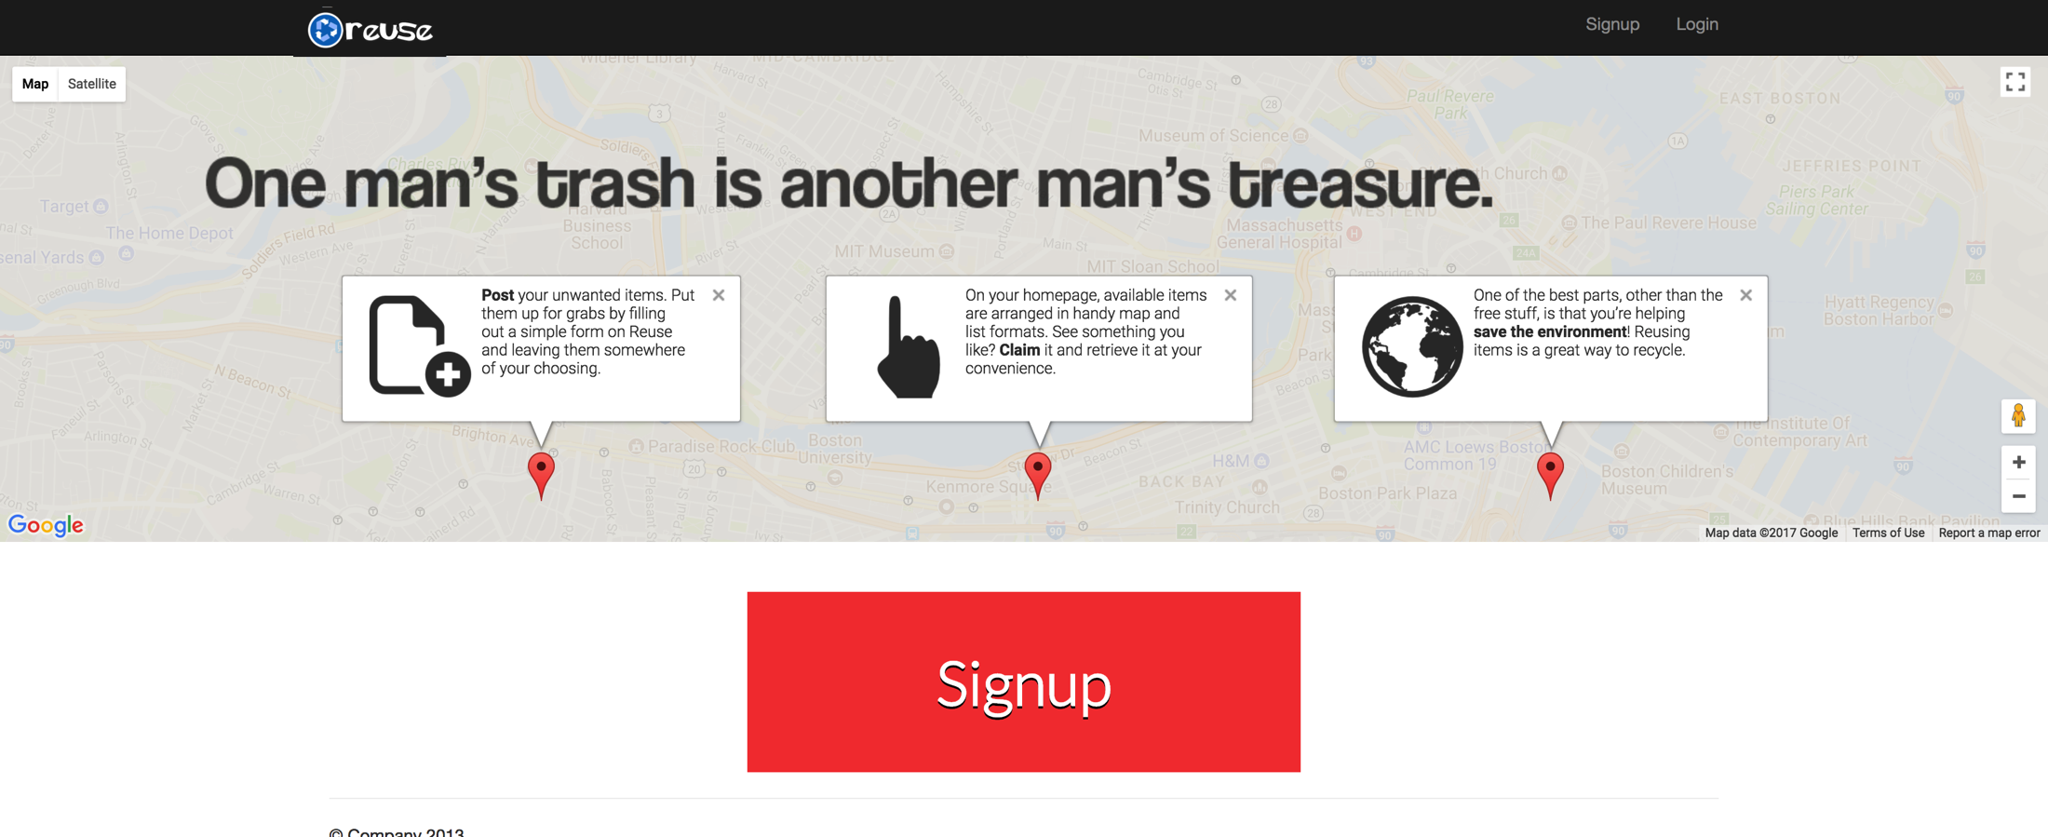

Slide 23


Slide 24

Notes:
Coursework and teaching

